Slide 1
Alignment and Scaling in Spanish Intonation: Recent Findings and their Implications for Sp_ToBI
Timothy L. Face
University of Minnesota

Slide 2
Introduction
Much work on Spanish tonal alignment and scaling
Phonetic description has always existed (from Navarro Tomás 1918 to Face 2008a)
Once we describe, though, we need to explain
How does/can Sp_ToBI do that?

Slide 3
Introduction
Based on AM framework, SP_ToBI attempts to merge levels and contours approaches
As with other AM work, the Sp_ToBI framework has shed more light on contours (and specifically alignment) than levels (scaling)

Slide 4
Introduction
This presentation:
  Recent alignment data
    How does Sp_ToBI fare?
  Recent scaling data
    How does Sp_ToBI fare?
  What are the implications of the data for Sp_ToBI?

Slide 5
Alignment
Commonly claimed contrast based on peak location: peak in stressed syllable vs. peak after stressed syllable. (Not the same in all varieties)
Recent alignment data
  Face 2003: Spontaneous speech – 25% early peak alignment in pre-nuclear position; often no indication that the word is in narrow focus

Slide 6
Alignment
  Ramírez Verdugo 2005: Finds considerably more variability in pitch accents (based on alignment) than previous studies. Peaks in stressed syllables in pre-nuclear position.
  Toledo 2006: Prominence (based largely on peak alignment) most often on stressed syllable; variation deemed phonetic and irrelevant to phonology

Slide 7
Alignment
  Díaz-Campos & Ronquest 2007: Perceptual discrimination task – listeners could not successfully discriminate between early and late peak alignment

Slide 8
Alignment
  Face 2007: Perception task – listeners had to choose question (eliciting broad or narrow focus) to which stimulus best responded. Alignment and height only. Early alignment required high peak for narrow focus perception, but even then not categorical. Height was stronger cue.

Slide 9
Alignment
  Face 2008b: Perception task – listeners had to choose question (eliciting broad or narrow focus) to which stimulus best responded. Various cues. Narrow focus never perceived more than broad focus except when there are no following peaks. Early alignment did not communicate narrow focus.

Slide 10
Alignment
  Some studies have proposed a 3-way contrast in rising accents – involving a valley contrast as well as peak contrasts (e.g. Face & Prieto 2007, Estebas & Prieto 2008)

Slide 11
Alignment
How does Sp_ToBI fare?
  Phonological distinction based on peak alignment: L*+H, L+H*
    Common analysis
    Different starredness of the L tones could be problematic
    Phonologizes a distinction that has been brought into question

Slide 12
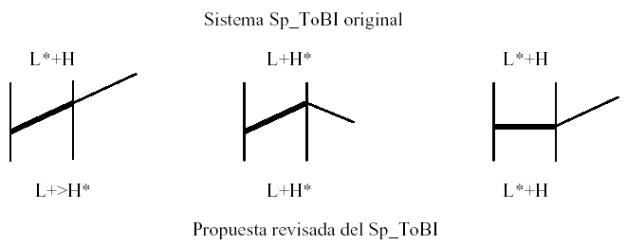
Alignment
  3-way contrast: L+>H*, L+H*, L*+H

Slide 13
Alignment
    Early peak explained by secondary association of same units having primary association (Face & Prieto 2007)
    Makes starredness of L tones consistent
    Other findings bring into question the consistency of this 3-way contrast

Slide 14
Alignment
Recent alignment data raise questions that need to be considered and investigated more fully.

Slide 15
Scaling
As is typical in AM analyses, Sp_ToBI considers two tonal levels for pitch accents: L, H
Varying from many AM analyses, Sp_ToBI considers three tonal levels for boundary tones: L, M, H (Beckman et al. 2002, Estebas & Prieto 2008). Boundary tones not considered here.

Slide 16
Scaling
Recent scaling data
  Prieto 2004: Significant differences in height of first F0 peak between sentence types in Peninsular Spanish. E.g., significantly higher in interrogatives than declaratives (as has been claimed in other studies).

Slide 17
Scaling
Face 2005: Gated perception study of declaratives and absolute interrogatives in Castilian Spanish. Listeners accurately identify sentence type 95% of the time as soon as they hear the portion containing the first F0 peak.
Face 2007: Confirms finding of Face 2005, but shows first peak to be only the third strongest intonational cue to this contrast.

Slide 18
Scaling
Lee, et al. 2008: For many speakers of Buenos Aires Spanish, information seeking and presumptive absolute interrogatives have the same contour in terms of alignment, but a dramatic difference in pitch scaling throughout the utterance (larger pitch range – both ends – for presumptive interrogatives). Cf. Ward & Hirschberg 1985, Hirschberg & Ward 1992

Slide 19
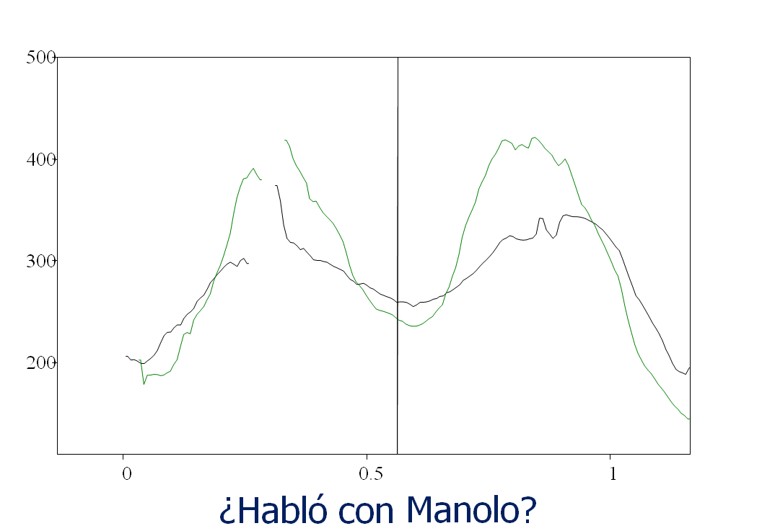
Scaling

Slide 20
Scaling
How does Sp_ToBI fare?
  Consistent with most AM analyses, Sp_ToBI recognizes only H and L tones for pitch accents
    Prieto 2004, Face 2005, 2007 point to a meaningful distinction between peak heights (contrastive scaling of H tones)

Slide 21
Scaling
    Upstep diacritic could be applied to H tone (i.e. ¡H), but the distinction is sentence-initial – there is nothing to upstep from; forced solution
    Use of M vs. H seems inappropriate since peaks are clearly high in both
    Sp_ToBI has no other mechanism available to distinguish between contrastive peak heights

Slide 22
Scaling
  Lee et al. 2008 find contrastive pitch scaling across utterance
    Sp_ToBI has no mechanism to deal with utterance-level pitch scaling
    Only local mechanisms would be ¡H or M vs. H, but affects initial position, peaks are high, this is an accent-level solution to an utterance-level issue, and it ignores L scaling

Slide 23
Implications for Sp_ToBI
Alignment issues that Sp_ToBI must account for:
  Variability with no difference in meaning: Are many of the observed alignment differences phonetic?
  Lack of perception of differences: discrimination and in meaningful contexts

Slide 24
Implications for Sp_ToBI
Proposed handling of alignment issues within Sp_ToBI:
  Add phonetic tier to phonological tone tier
    Tone tier to be conservative: don’t phonologize distinctions without solid evidence, including perceptual

Slide 25
Implications for Sp_ToBI
    Phonetic tier to notationally represent more detailed alignment differences
    Current L*+H, L+H*, L+>H* would correspond to phonetic tier
    Phonological tone tier might contain only L+H (or L+H*) for each of these at this point

Slide 26
Implications for Sp_ToBI
    Phonetic tier facilitates investigation of possible phonological distinctions
Scaling issues that Sp_ToBI must account for:
  Meaningful differences in peak height
  Meaningful utterance-level scaling differences, at the high and low end of the pitch range

Slide 27
Implications for Sp_ToBI
Proposed handling of scaling issues within Sp_ToBI:
  Any proposal is very tentative – much more research needs to be done on meaningful aspects of pitch scaling
    Very little perceptual research
    No perceptual research dealing with cases where both ends of the tonal range are affected

Slide 28
Implications for Sp_ToBI
  Incorporate scaling as part of the tone tier, being cautious not to over phonologize
  Brackets can indicate beginning and end of tonal range changes, with H or HL indicating the high end or both, and +/- the direction.
    _{H+}[ ], _{H+L-}[ ], etc.
    ₀[ ] for normal range

Slide 29
Implications for Sp_ToBI
  Examples:
  María viene mañana
  ₀[ L+H L+H L%]
  ₀[ L+>H* L+H* L%]
  ¿María viene mañana?
  _{H+}[L+H ] ₀[ L+H H%]
  _{H+}[ L+>H*] ₀[ L*+H H%]

Slide 30
Implications for Sp_ToBI
  ¿María viene mañana?
  ?[L+H L+H L+H L%]
  _{H+L-} [ L+H* L+H* L*+H L%]

Slide 31
Conclusions
Recent data on both alignment and scaling present challenges for Sp_ToBI
Introducing a phonetic tier and not phonologizing differences without sufficient evidence is important
Perceptual evidence is indispensible

Slide 32
Conclusions
Scaling is a bigger challenge than alignment, and I have presented a starting place for accounting for it phonologically
Sp_ToBI has always aimed to be a pan-Spanish system, which is fine, but…
We must be careful not to take the proposed inventory of accents and boundary tones as available in all varieties

Slide 33
Conclusions
Recognizing both phonological and phonetic differences, and carefully distinguishing between them, will enrich our understanding of the array of intonation patterns across Spanish

